Slide 1




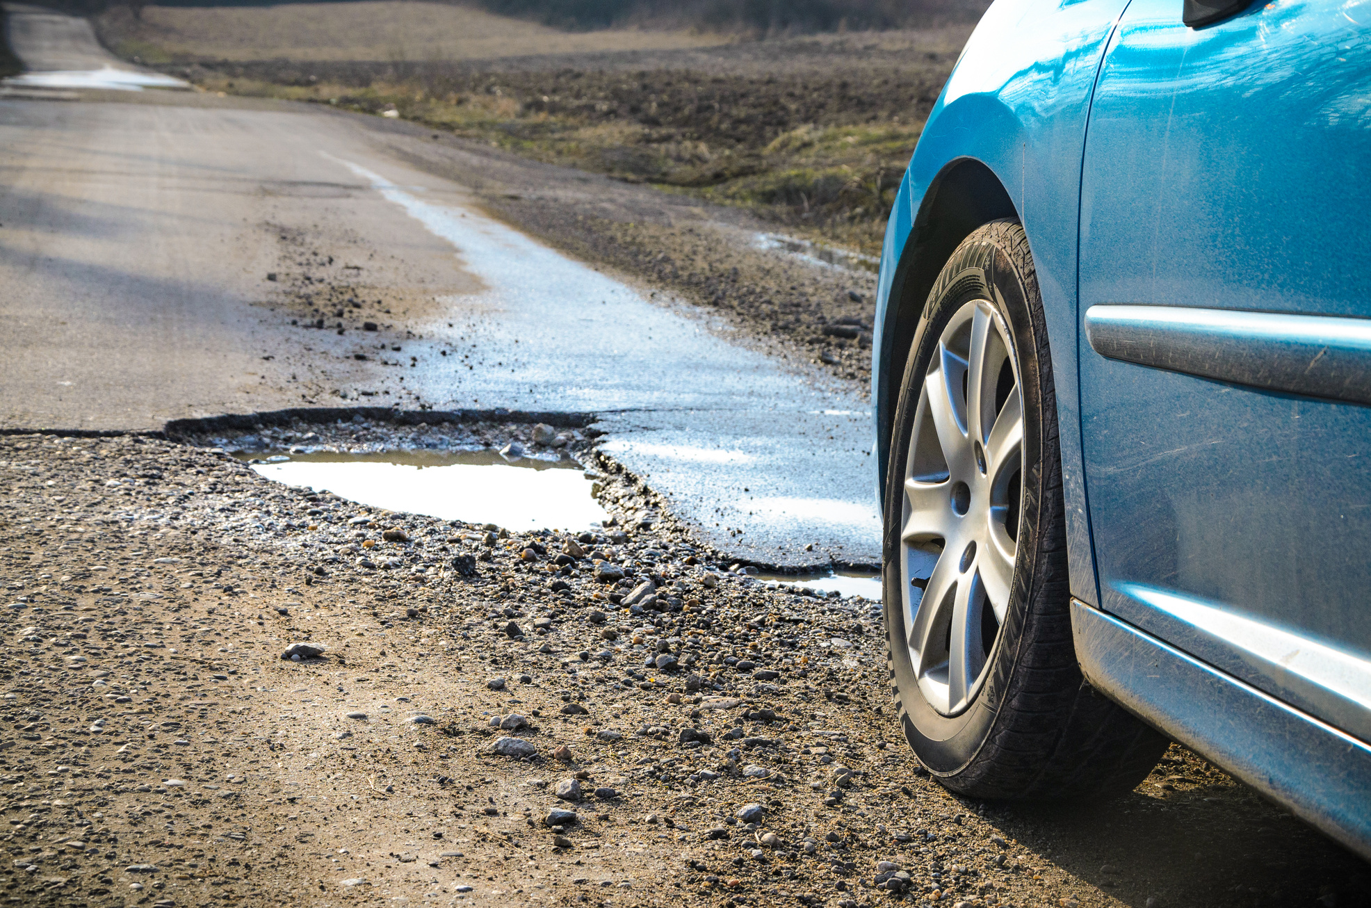
Falcoeye
Smartathon Pitch Deck
Falcoeye
2D Multi-Model platform for intelligent data acquisition and analysis
Application on road damage and potholes identification

Slide 2

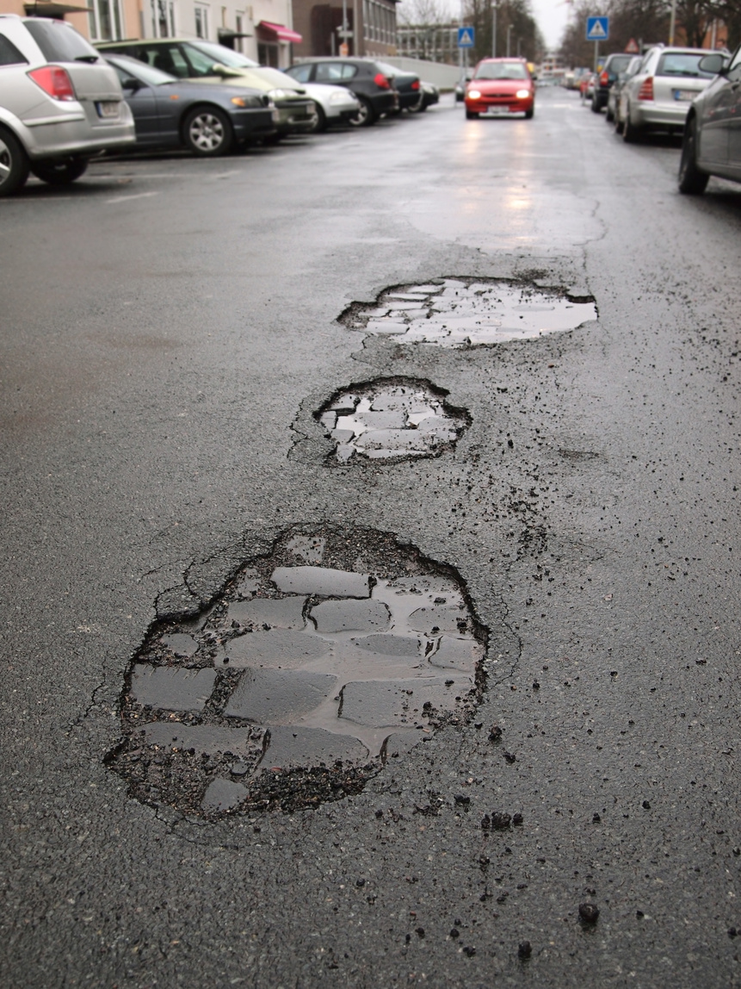
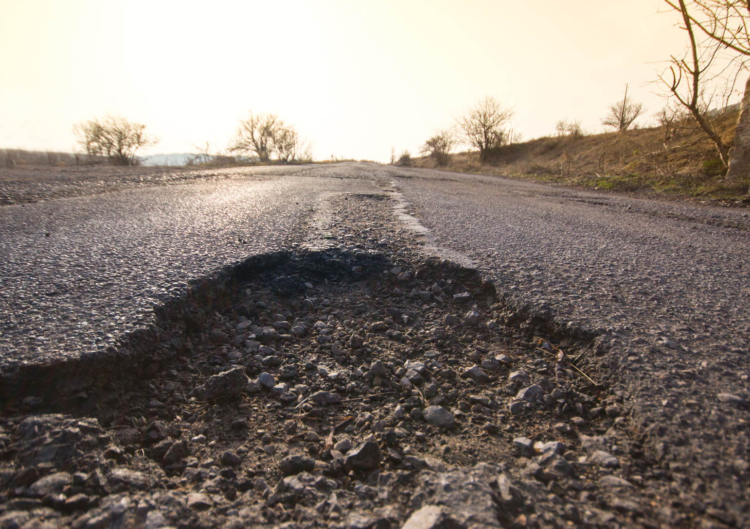

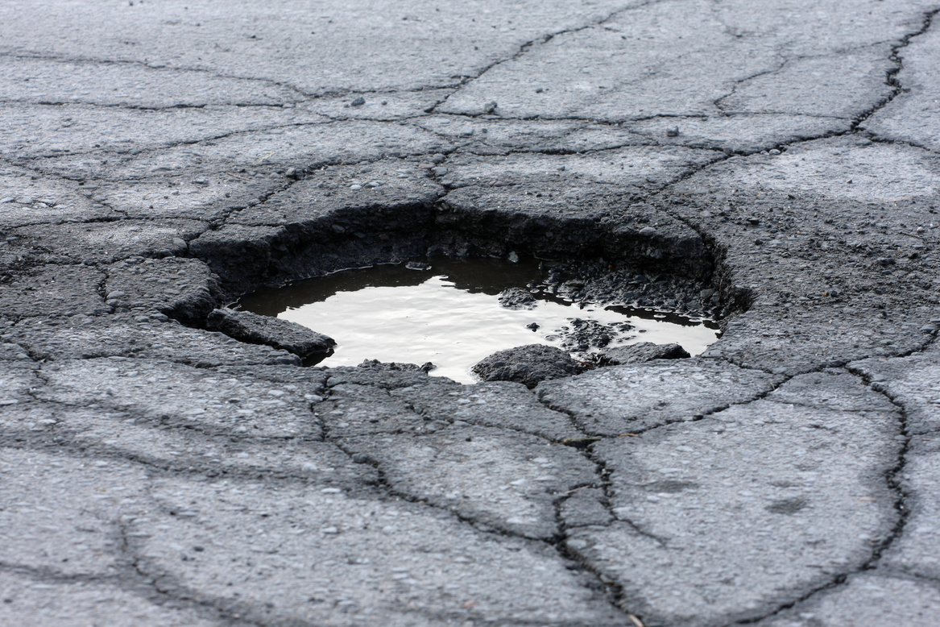
Falcoeye
PROBLEMS
NOWADAYS
Potholes are a major issue for road maintenance agencies, causing damage to vehicles and posing a safety risk to drivers and passengers. To efficiently repair potholes, it is important to accurately identify and classify them according to their severity.

Slide 3



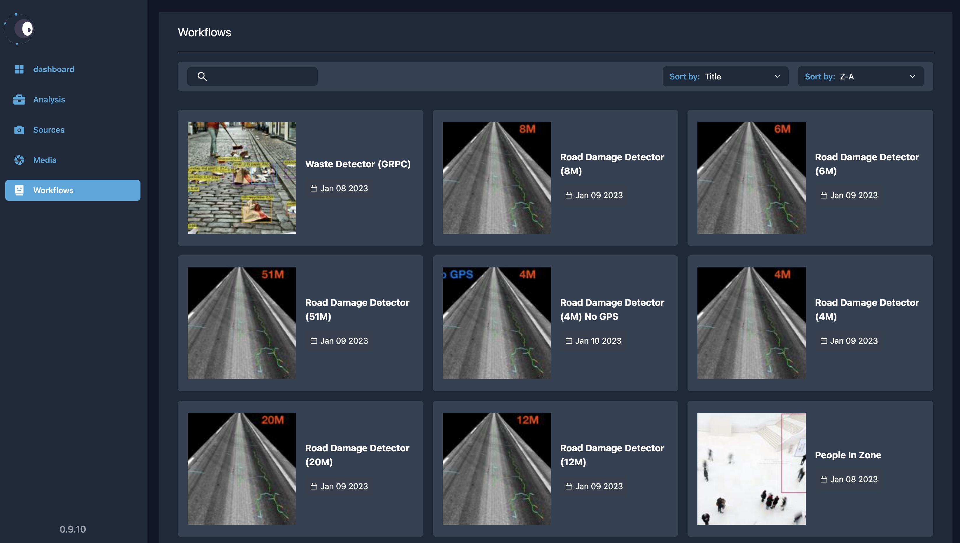


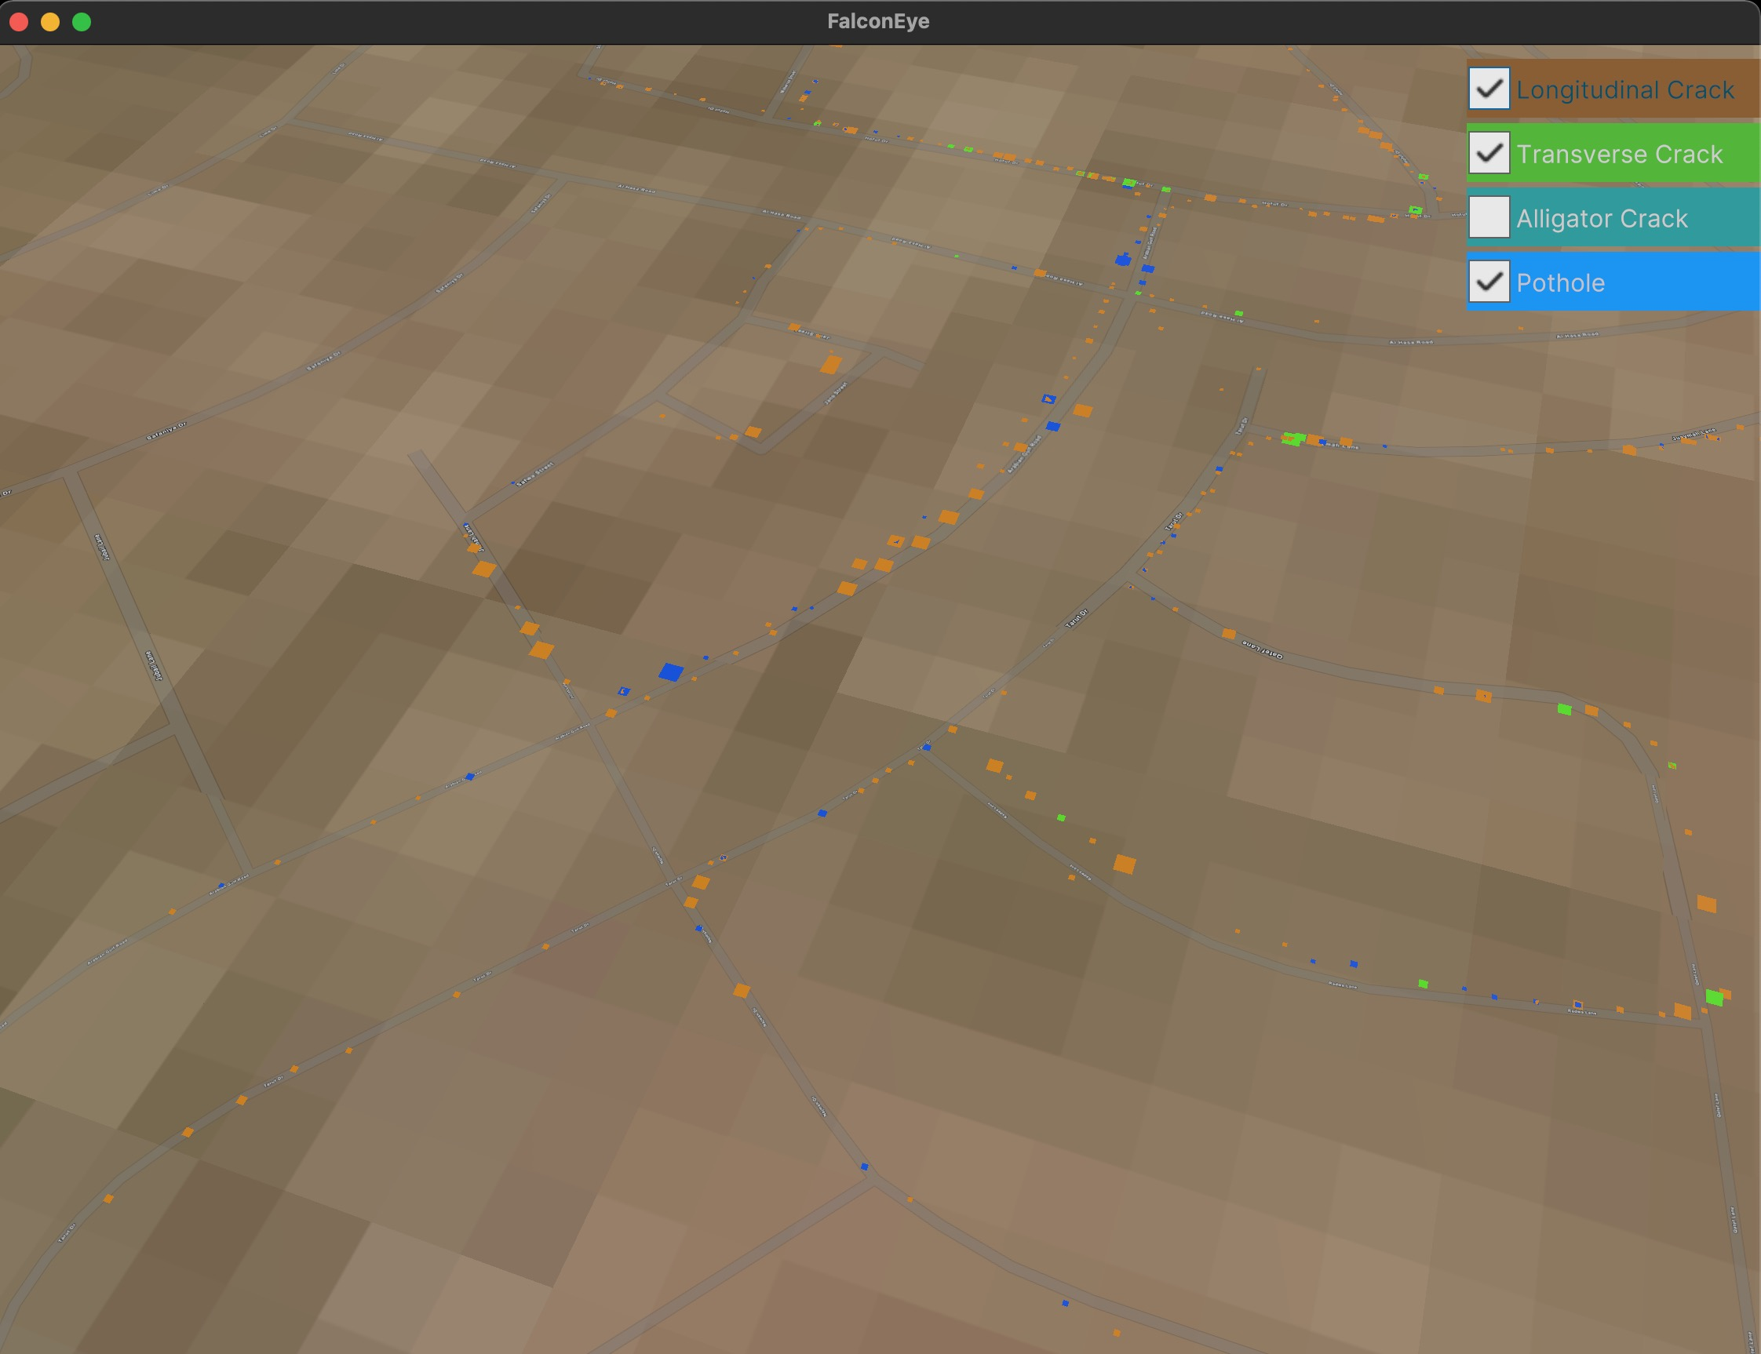
Falcoeye
Solution
Using a low-cost dashcam equipped with GPS
Falcoeye, the AI platform that will be used to extract pothole data and GIS information
3D GIS Visualization dashboard

Slide 4


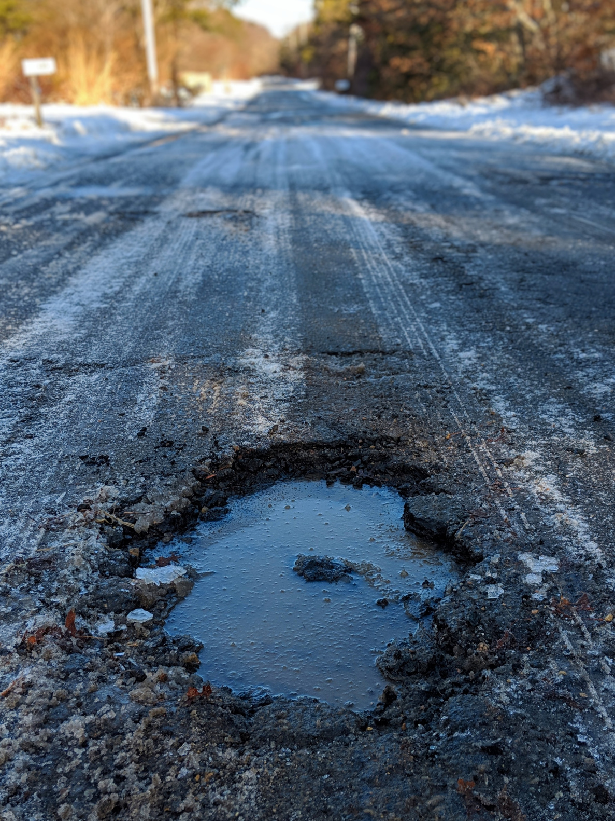




LOW COST
low-cost dash-cam can be easily deployed on a large scale, making it an affordable solution for road maintenance agencies
MULTIPLE WORKFLOW
Benefits:
Using ensable of AI workflows give more accurate and more holistic estimate of the distribution of road damages
3D MODELING & RENDERING
The 3D environment allows for immersive and digital view of the roads and set the ground for a digital twin experience

Slide 5

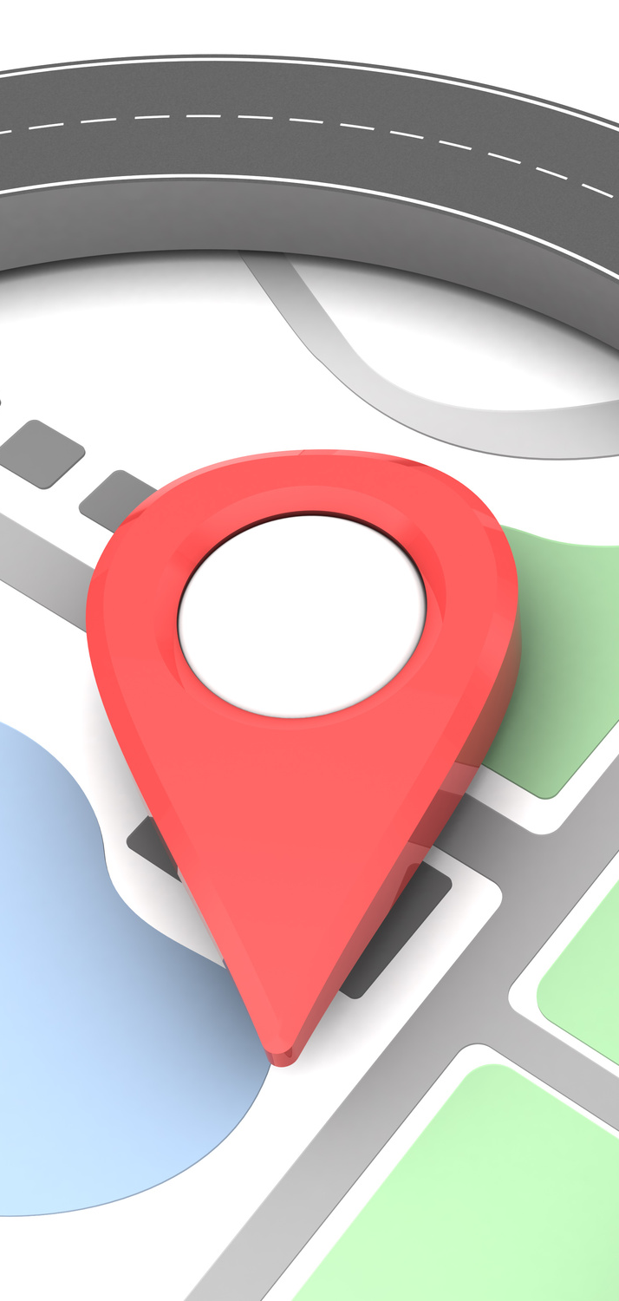
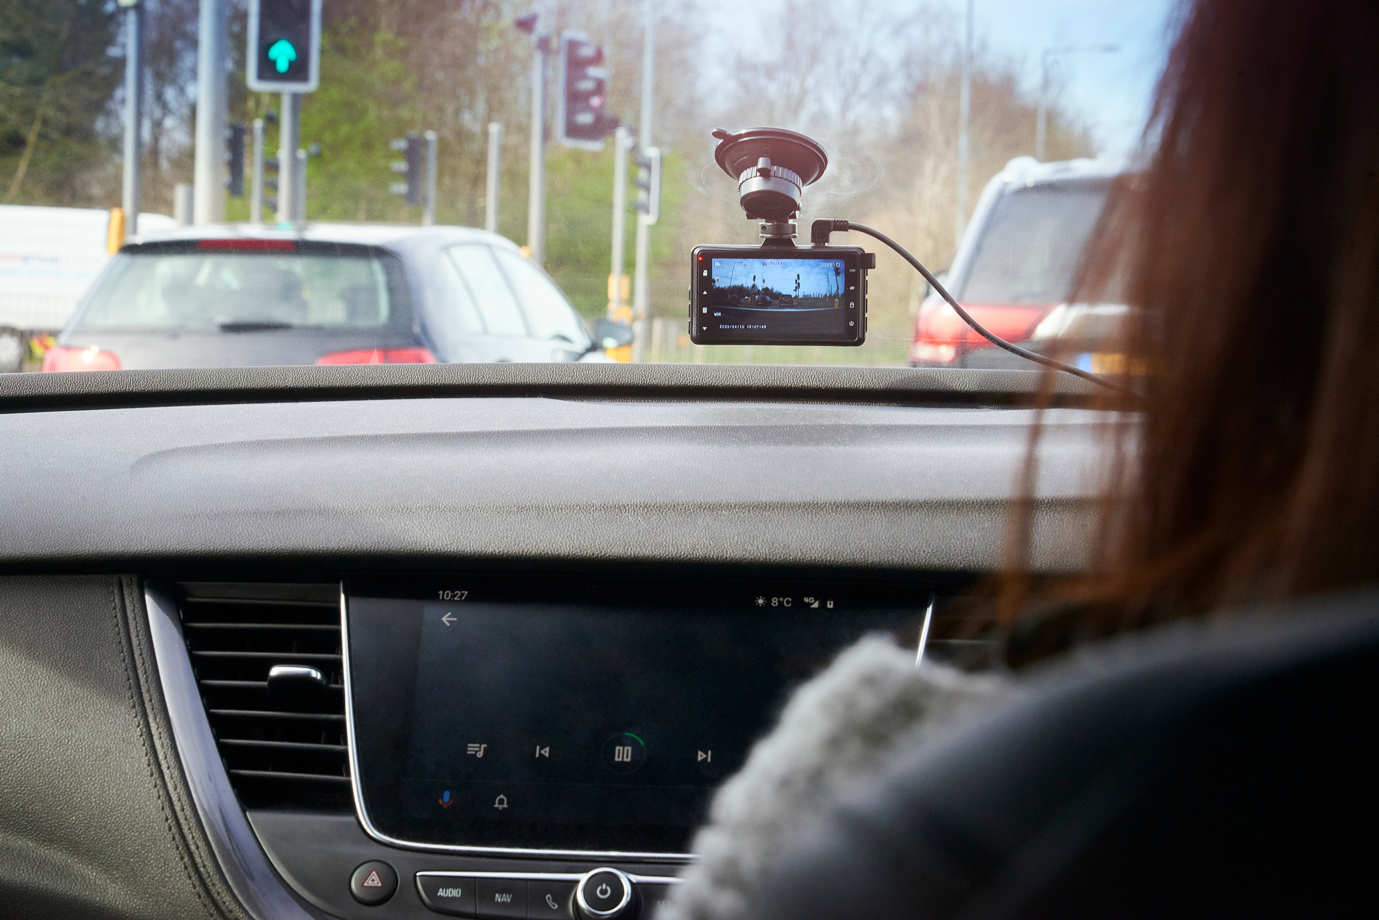
Falcoeye
Dash-Cam
Capture the Footage
A dash-cam will be mounted on a vehicle to capture video footage of the road as the vehicle travels
Get Geographical Info
The dash-cam will be equipped with GPS to provide accurate geographical information for each frame of the video
Share-Riding Drivers
The dash-cams can be provided to share-riding drivers to cover most of the city as part of their daily job. This will ensure coverage of highways, as well as living areas

Slide 6


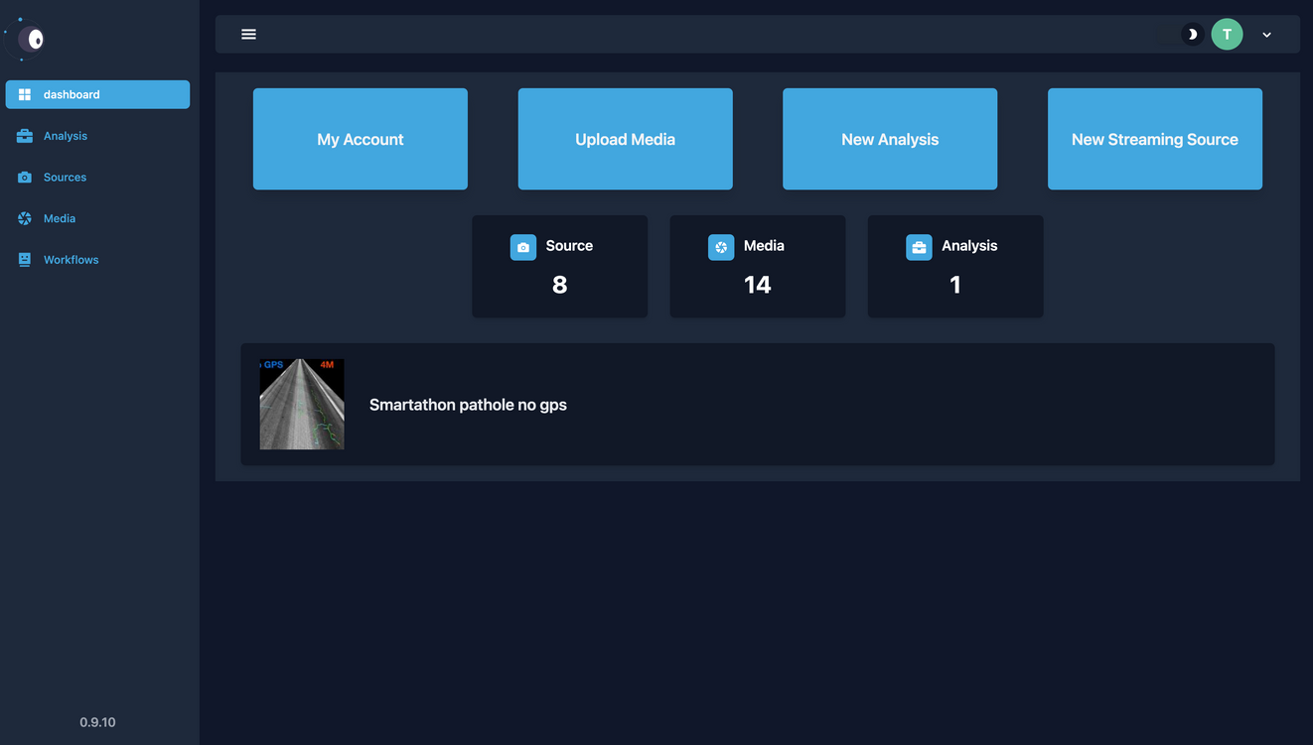
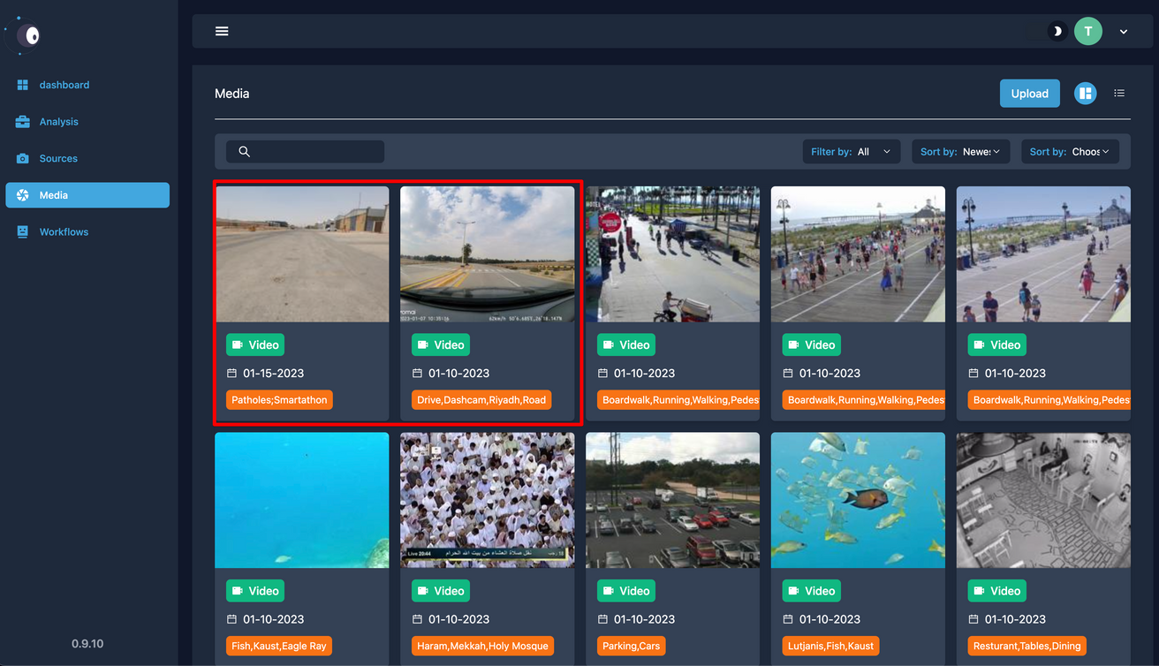
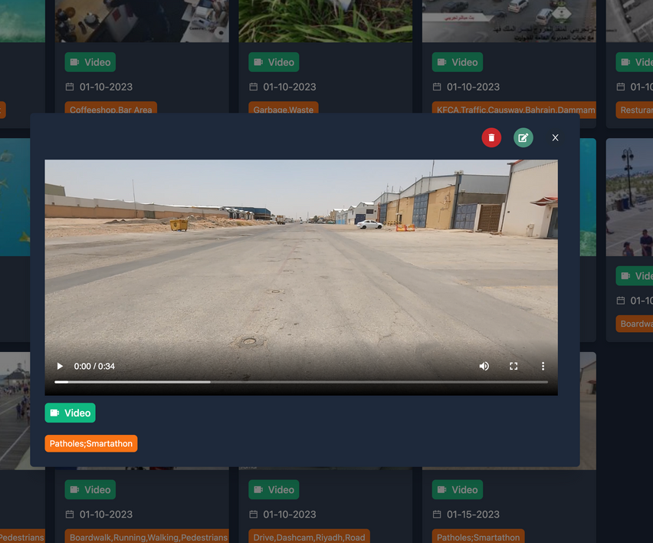


Falcoeye
Falcoeye is the platform that we have developed to host the pothole detection workflows and provide the user interface for uploading dash-cam videos and extracting pothole data, including classification, abundance, and shape, along with GIS information.
What Is
Falcoeye?

Slide 7

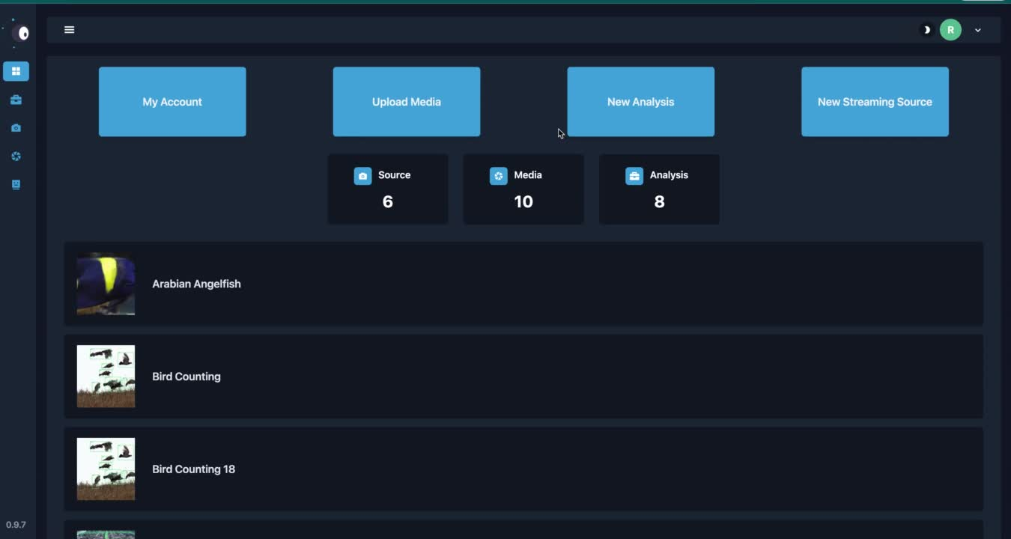


Falcoeye Platform
The platform can scale automatically on a Kubernetes cluster
Developers can build new workflows and aggregation techniques

Slide 8
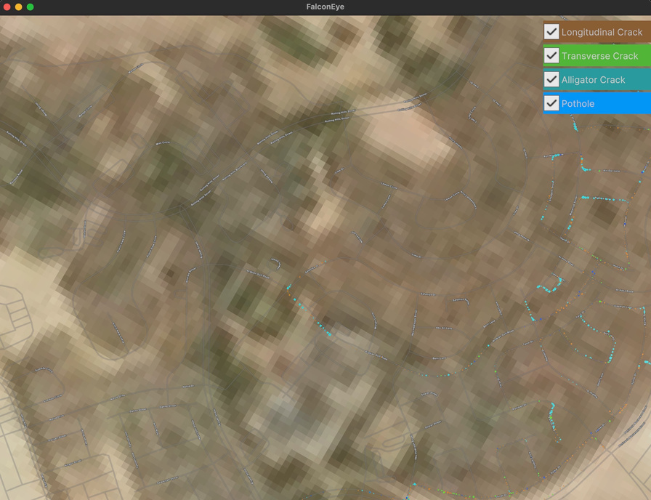

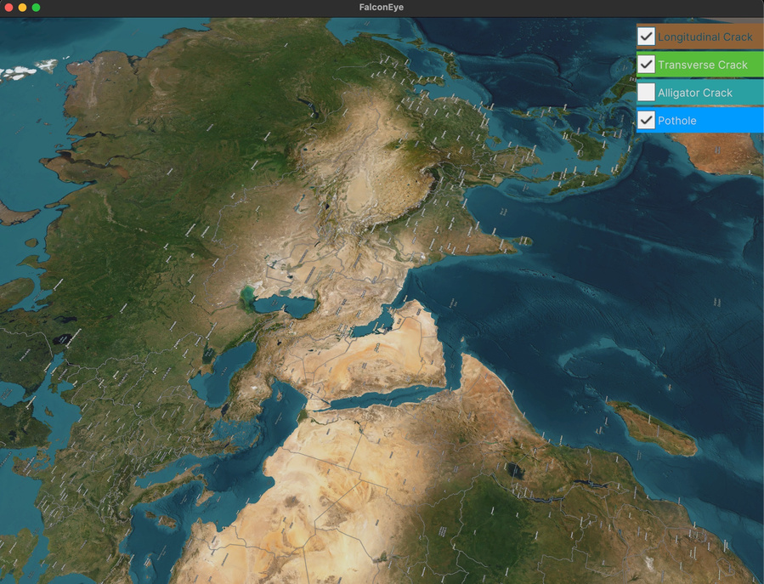
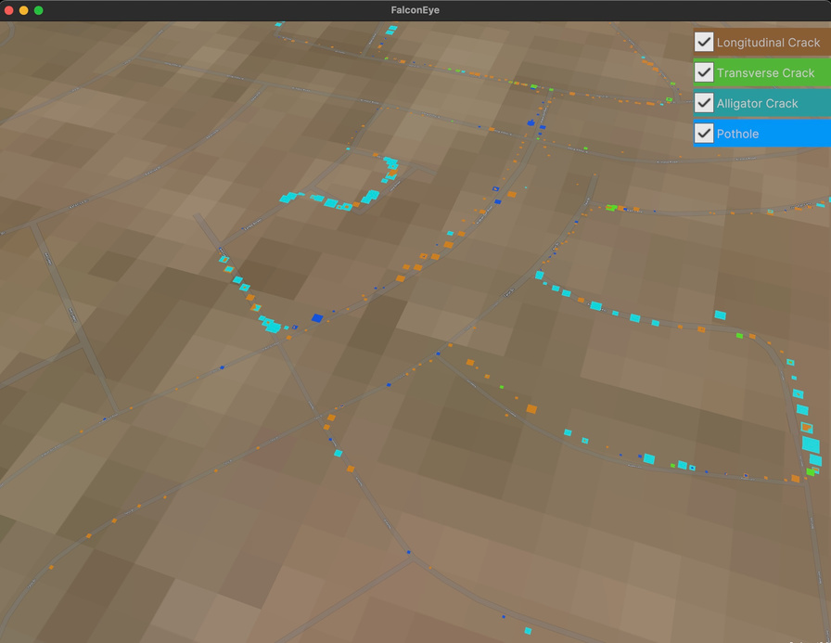
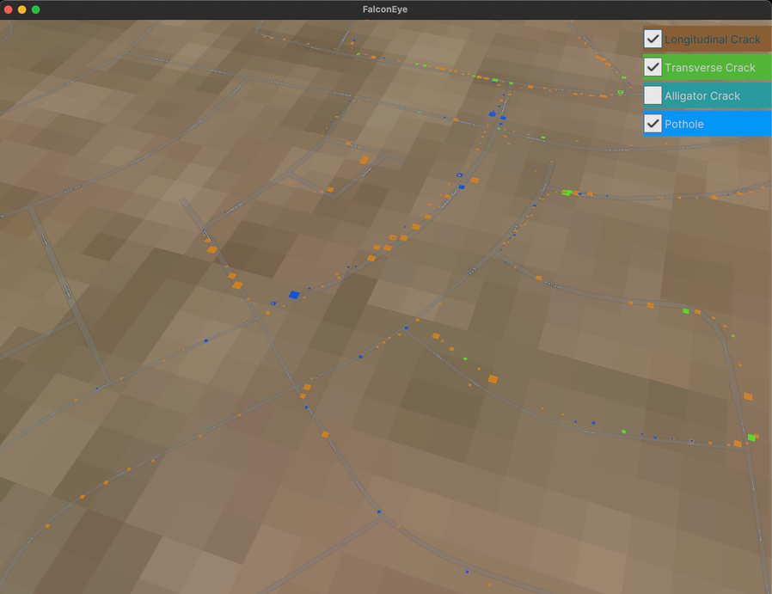

Falcoeye
Visualization & Analysis
We have also implemented a 3D dashboard with a GIS map and filters. The data extracted from Falcoeye is reprojected on the GIS map:
This allows for a better understanding of the distribution of potholes in a given area and can aid in prioritizing repairs.
The 3D application enables the user to filter the data by pothole type, size, and severity, allowing for more targeted analysis of the data.
The user can also navigate in the map using a 3D model and see the potholes in the context of the road.

Slide 9
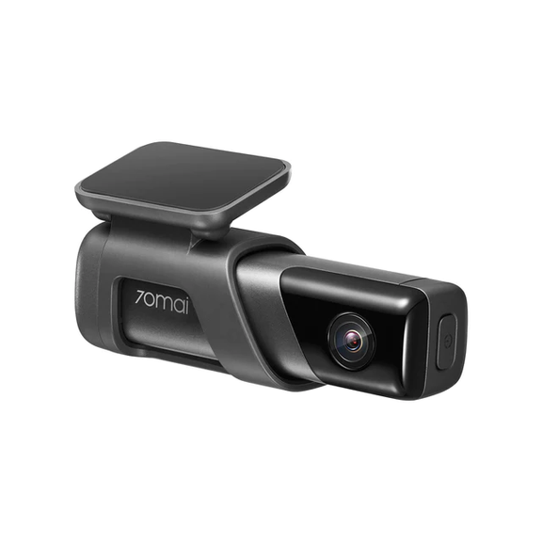
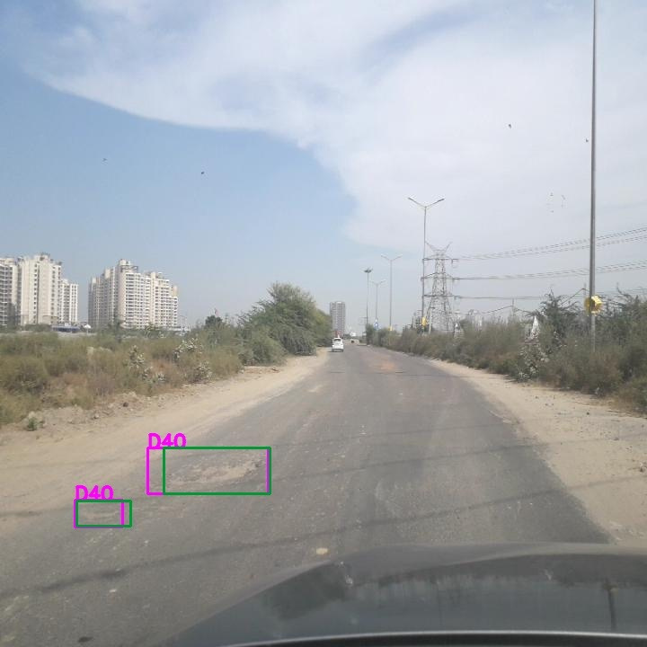
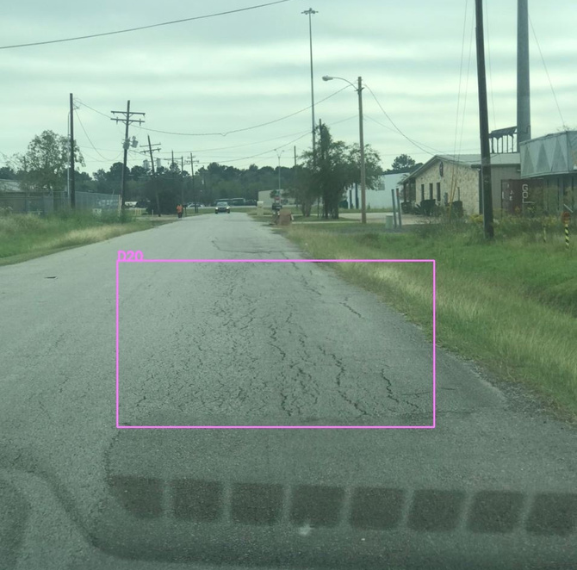
Falcoeye
CASE STUDY
Built multiple AI workflows based on EfficientNet for the extraction and aggregation of the data
70mai True 2.7K 1944P M500 (120$)
Classify the road damage into 4 categories
Longitudinal Crack
Transverse Crack
Alligator Crack
Pothole

Slide 10
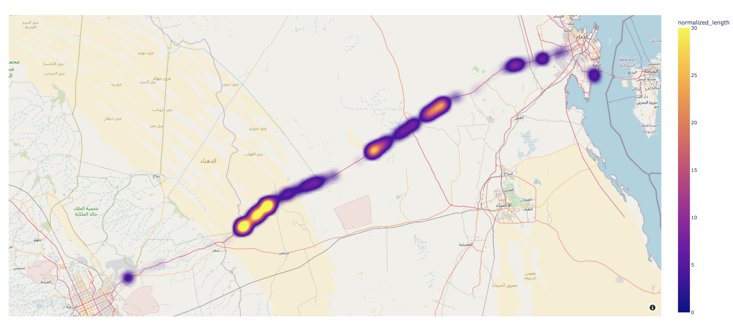
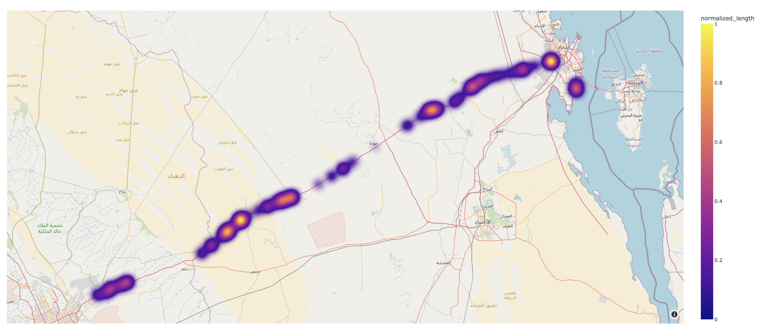
Falcoeye
Riyadh-Dammam Intercity
Data:
4 hours of driving video at average speed of 120 km/h
Resolution: 2592 X 1944
Frame Rate: 30 f/s
Alligator Crack
Model:
Model type: EfficientNet
Model size: ~4 Million Parameters
Sample rate: 6/s (1 every 5 frames)
Device: Nvidia A100
Time: 5 hours
Pothole
Findings:
26992 Longitudinal Crack
4675 Transverse Crack
1002 Alligator Crack
316 Pothole

Slide 11





Falcoeye
FutureWork
Extract detailed information per detection such as shape, size, direction, and depth
- Parametric pothole mesher
- Displacement depth map
1. Using deep learning
2. Stereo view (pair of dash-cams)
AR/VR experience of detections

Slide 12


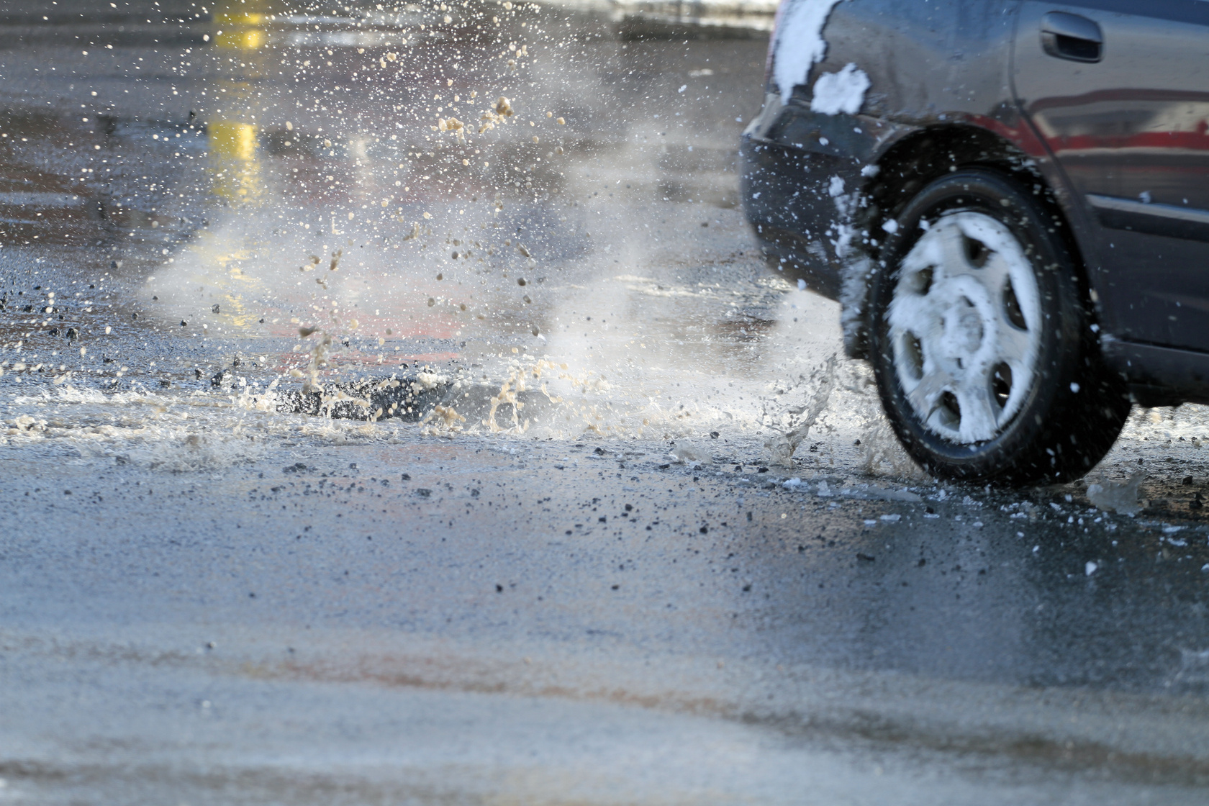
Thank You For Your Attention
In conclusion, the proposed pothole detection and severity classification system using a low-cost dash-cam with GPS and a set of pothole detection workflows served on Falcoeye, combined with a 3D application for data visualization and analysis
The system has the potential to significantly improve road safety and reduce the cost of road maintenance for agencies.

